Slide 2



















Tahaluf Copyright 2022- All Right Reserved
Harmony IT Solution
learning Hub
Angular
Tahaluf Training Center 2022

Slide 3



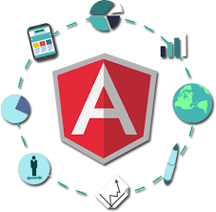





Tahaluf Copyright 2022- All Right Reserved
Harmony IT Solution
1
What is Angular?
2
Advantages of Angular.
3
Angular Versions.
4
Single-Page Application.
5
5
Create Angular Project.
6
6
Flow of Execution of Angular App.
7
7
Component in Angular.
8
Generate a new component.
8
8
9

Slide 4










Tahaluf Copyright 2022- All Right Reserved
Harmony IT Solution
Objective

Slide 5
Tahaluf Copyright 2022- All Right Reserved
Harmony IT Solution
The Objective of this lecture
Find out what Angular is in all versions.
Distinguish between the concept of a single-page application and a multi-page application.
Download the Angular package and create your first project with Angular.
Understanding the component and how to create it using the terminal.

Slide 6
Tahaluf Copyright 2022- All Right Reserved
Harmony IT Solution
What is Angular?

Slide 7
Tahaluf Copyright 2022- All Right Reserved
Harmony IT Solution
Overview of Angular
Angular is a development platform for building Single Page Applications.
It uses Typescript & HTML to build Apps.
The Angular itself is written using Typescript.
It now comes with every feature you need to build a complex web or mobile application.

Slide 8
Tahaluf Copyright 2022- All Right Reserved
Harmony IT Solution
Overview of Angular
It comes with features like Component, Directives, Forms, Pipes, HTTP Services, Dependency Injection, etc.
Angular website:
https://angular.io/

Slide 9
Tahaluf Copyright 2022- All Right Reserved
Harmony IT Solution
Advantages of Angular

Slide 10
Tahaluf Copyright 2022- All Right Reserved
Harmony IT Solution
1. Comprehensive:
The angular framework is a full-featured framework that provides out-of-the-box solutions for server communication, routing, and more.
2. Browser Compatibility:
Angular is cross-platform and compatible with multiple browsers.
3. Testing:
Testing is a first-class tool, and Angular was built to be testable from the beginning.

Slide 11
Tahaluf Copyright 2022- All Right Reserved
Harmony IT Solution
4. Custom Components:
Angular allows users to build their own components that can pack functionality along with rendering logic into reusable pieces.
5. Data Binding:
Angular allows users to effortlessly move data from JavaScript/TypeScript code to the view and react to user events without having to write any code manually.
6. Dependency Injection:
Allows users to write modular services and inject them wherever they are needed.

Slide 12
Tahaluf Copyright 2022- All Right Reserved
Harmony IT Solution
Angular Versions

Slide 13
Tahaluf Copyright 2022- All Right Reserved
Harmony IT Solution
The early version of Angular was named AngularJS.
Then later it was renamed just Angular. Angular Versions:
AngularJS 1. X
Angular 2
Angular 3
Angular 4
Angular 5
Angular 6
Angular 7

Slide 14
Tahaluf Copyright 2022- All Right Reserved
Harmony IT Solution
Angular Versions:
Angular 8
Angular 9
Angular 10
Angular 11
Angular 12
Angular 13
Angular is constantly growing with better features and faster performance.

Slide 15
Tahaluf Copyright 2022- All Right Reserved
Harmony IT Solution
Single-Page Application

Slide 16
Tahaluf Copyright 2022- All Right Reserved
Harmony IT Solution
Single-Page Application
Multi-Page Application
VS.

Slide 17
Tahaluf Copyright 2022- All Right Reserved
Harmony IT Solution
Multi-Page Applications
Multi-Page Applications (MPA) were traditionally used, where every time you clicked on a link, a new page was loaded from the server. Additionally, it was time-consuming and increased server load, which slowed the website.

Slide 18
Tahaluf Copyright 2022- All Right Reserved
Harmony IT Solution
Single Page Applications
The concept of a single page application refers to a web application that loads a single HTML page and only a part of the page gets updated on each mouse click rather than the entire page. There is no reloading of the page or transfer of control to another page during the process. The result is high performance and faster loading pages.

Slide 19
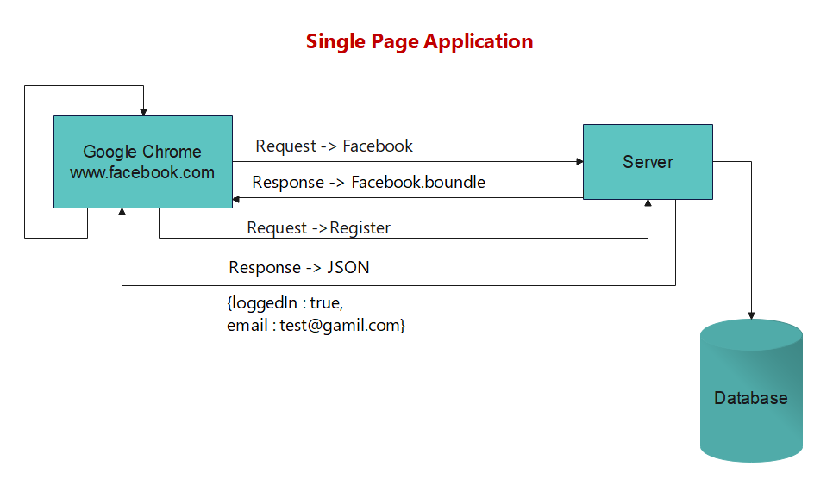
Tahaluf Copyright 2022- All Right Reserved
Harmony IT Solution

Slide 20



Tahaluf Copyright 2022- All Right Reserved
Harmony IT Solution
Single Page Applications Example
Twitter
Git Hub
PayPal

